Slide 1
Data Breach investigation
Secure and simple data forensics

Slide 2
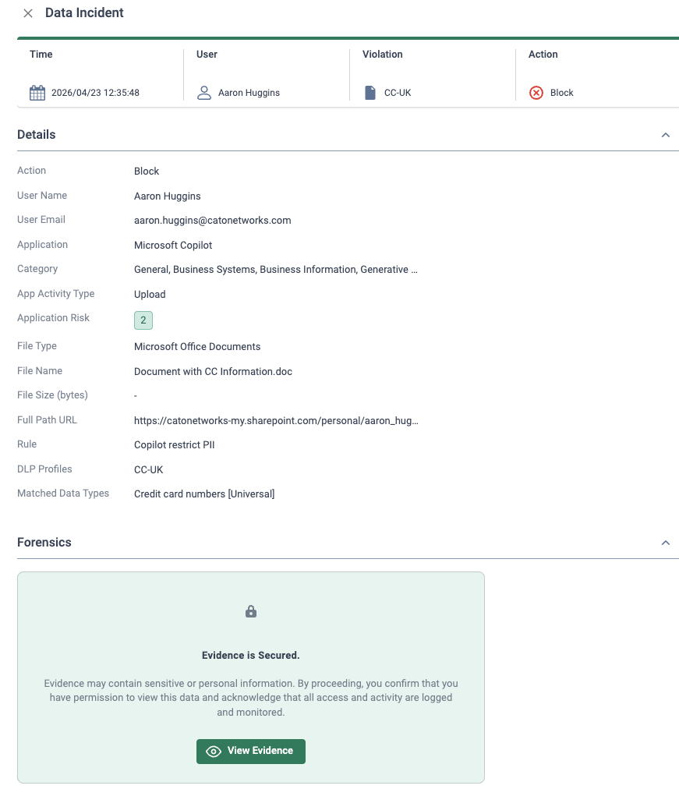
Business objective overview
DLP Forensics Evidence
The use case
Security teams need to determine whether an event is a real data leak or a false positive.
In the event of an incident forensics are required to determine the impact.
The Solution
DLP Forensics: Customer-owned storage with secure and encrypted forensics retrieval, fully governed by RBAC and auditing.
The Value
Seamless DLP Incidents Investigation directly from the CMA

Slide 3
DLP Forensics
🔗 Forensics Encryption
All forensics are encrypted and stored using a per-account unique encryption key.
🔑 RBAC
All forensics are governed by RBAC.
📋 Audit & Activity Logging
All actions related to DLP Forensics are fully audited (Config change, view forensics, etc.)
⚙️ DLP Forensics
Full file storage is supported for files up to 20MB.

Slide 4
How to
Configure AWS S3 bucket, IAM Policy and role
https://support.catonetworks.com/hc/en-us/articles/32769630749085-Amazon-S3-Configuring-the-Forensic-Storage-Connector
Enable the DLP forensics integration and add the role & permissions
https://support.catonetworks.com/hc/en-us/articles/32572506261789-Investigating-DLP-Violations-with-Forensic-Evidence
Upload a file including sensitive PII such as credit card data to CoPilot
Find the relevant event from the data protection dashboard .Click on the ”view forensics” from the evidence field.
Open the data incident page and click on “view evidence” to view and download the data snippet.

